Slide 1

The Quantum Imperative: Preparing for the Post-Quantum Era
Technical Potential, Security Risks, and the Role of Governance
Agenda
Technical Foundations (QC/Qubit Tech)
Real-World Applications (Quantum Advantage)
Security & The PQC Solution (The Quantum Threat & NIST)
Regulatory & Ethical Frameworks (NIST, WEF, GDPR)
Case Studies (Operational Challenges)
(Nielsen & Chuang, 2010)
Notes:
Script: "Good morning/afternoon. My name is [Your Name], and today I will be evaluating the future of computing through the lens of Quantum Computing. As we stand on the brink of a 'Quantum Revolution,' we see a technology that promises to solve problems in seconds that would take classical supercomputers millennia. However, this power brings a 'Quantum Paradox': the same technology that could cure diseases could also dismantle the digital trust our global economy is built upon. Today, I will critically evaluate the technical foundations of QC, its security risks—specifically the 'Quantum Apocalypse'—and the ethical frameworks required to govern its use."

Slide 2
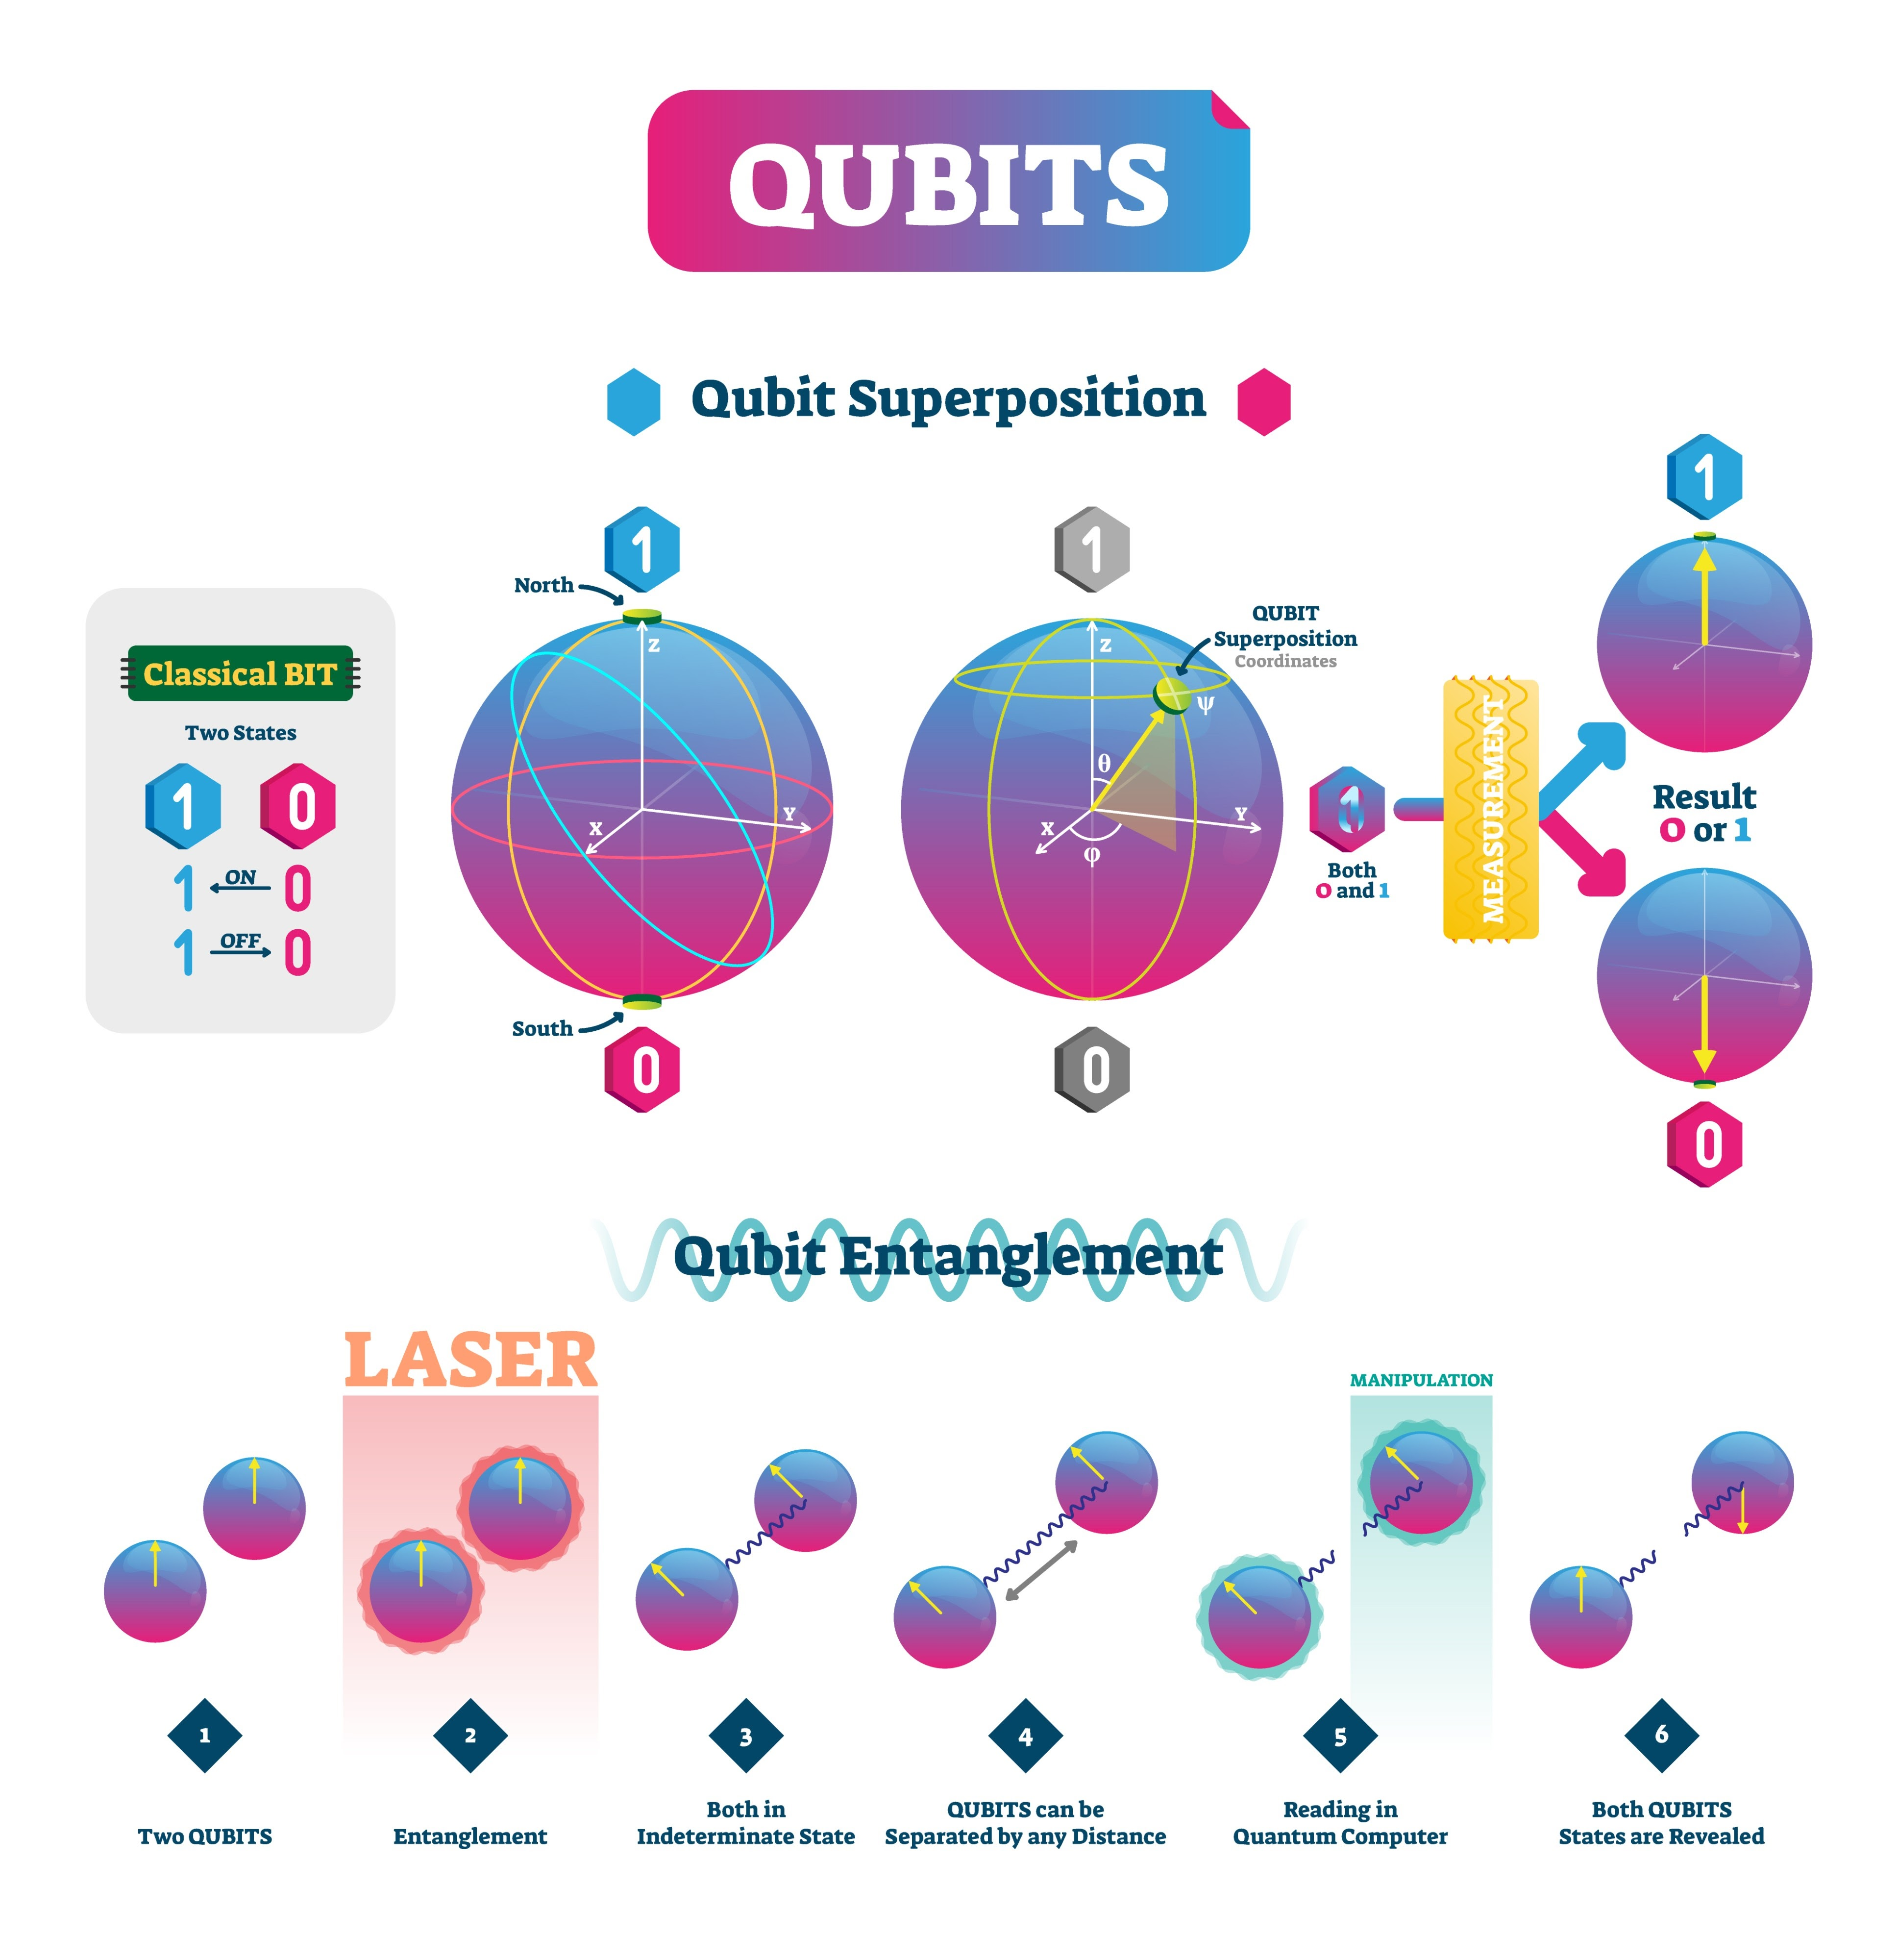
Qubits, Superposition, and Entanglement
Classical Bits vs. Qubits: Classical bits are 0 or 1. Qubits exist in a superposition of both states simultaneously.
Superposition: The ability of a qubit to represent a combination of 0 and 1 until measured, allowing for parallel computation
Entanglement: A unique quantum link where the state of one qubit instantaneously determines the state of another, regardless of distance. This is the mechanism for correlated information processing.
Algorithms
Shor's Algorithm: Factorizes large numbers exponentially faster than classical computers, directly threatening RSA and ECC.
Grover's Algorithm: Provides a quadratic speedup for unstructured database searches
(NIST, 2025)
Notes:
Script: "At the core of this technology are qubits. Unlike classical bits, which are strictly 0 or 1, qubits exist in a superposition, representing a combination of both states simultaneously until they are measured. This allows for massive parallel computation.
We also utilize entanglement, a unique quantum link where the state of one qubit determines the state of another regardless of distance. As Nielsen and Chuang noted, this is the fundamental mechanism for correlated information processing that gives quantum computers their edge over classical systems."

Slide 3
Transforming Industry: Applications of Quantum Computing
Quantum computers excel at simulation and optimization problems intractable for classical supercomputers.
Chemistry & Materials Science: Simulating molecular interactions with precision, accelerating drug discovery, and developing novel catalysts .
Finance: Portfolio optimization, high-frequency trading arbitrage detection, and complex risk modelling (e.g., Monte Carlo simulations).
Logistics & AI: Solving large-scale optimization problems like complex vehicle routing and supply chain management using algorithms like QAOA (Quantum Approximate Optimization Algorithm)
(Marino et al., 2025) and (Olasehinde, 2023)
Notes:
Script: "Where does this 'Quantum Advantage' manifest? In Chemistry, we can simulate molecular interactions at an atomic level, bypassing the trial-and-error of traditional drug discovery. In Finance, firms are already exploring Monte Carlo simulations and portfolio optimization to detect arbitrage in high-frequency trading. Logistics is perhaps the most immediate application. Using the Quantum Approximate Optimization Algorithm, or QAOA, enterprises can solve 'traveling salesperson' problems at a scale previously thought impossible. The ethical dilemma here is Resource Inequality. If only the top 1% of enterprises can afford these insights, the competitive gap between global giants and SMEs will become an unbridgeable chasm, potentially stifling market innovation."

Slide 4
The Quantum Cryptographic Apocalypse: Shor's Algorithm
Primary Threat: Shor's Algorithm: Breaks the mathematical foundation of current public-key cryptography (PKC), specifically RSA and Elliptic Curve Cryptography (ECC)
The 'Harvest Now, Decrypt Later' (HNDL) Threat: Adversaries are currently harvesting vast amounts of encrypted data (diplomatic, financial, medical) and storing it. When a Cryptographically Relevant Quantum Computer (CRQC) is built, this data will be rapidly decrypted . This is an immediate threat to long-lived, sensitive data.
Affected Systems: TLS/SSL (HTTPS), VPNs, Digital Signatures, and Blockchain integrity (as most use ECC for transaction verification).
(Smith & Doe, 2024)
Notes:
Script: "We must now address the 'Quantum Cryptographic Apocalypse.' Most of our modern security—RSA and Elliptic Curve Cryptography—relies on the mathematical difficulty of factoring large numbers. Shor’s Algorithm changes that by factorizing these numbers exponentially faster, effectively breaking the foundation of Public Key Cryptography. This leads to the 'Harvest Now, Decrypt Later' (HNDL) threat. Adversaries are currently intercepting and storing encrypted diplomatic and financial data, waiting for the day a Cryptographically Relevant Quantum Computer is built to unlock it. For an enterprise, this means your data today is already at risk for the next decade. This threatens not just websites via TLS, but the very integrity of Blockchain ledgers, which rely on ECC for transaction signatures."

Slide 5
Post-Quantum Cryptography (PQC) and the NIST Transition
PQC (or Quantum-Resistant Cryptography) consists of new mathematical algorithms secure against attacks by both classical and quantum computers.
Standardisation:
NIST PQC Standardization Project: The U.S. National Institute of Standards and Technology (NIST) led a multi-year global effort to select and standardize new PQC algorithms.
Primary Standards (FIPS 203, 204, 205): ML-KEM (Key Encapsulation) and ML-DSA / SLH-DSA (Digital Signatures). These are primarily based on Lattice-based cryptography
Challenge: Cryptographic Agility: Organizations must develop the ability to rapidly swap out cryptographic modules across all systems—a complex, multi-year, and costly IT migration effort.
(NIST, 2024)
Notes:
Script: "The defense against this is Post-Quantum Cryptography (PQC). Unlike quantum hardware, PQC is software-based math—such as Lattice-based cryptography—that is resistant to both classical and quantum attacks. The National Institute of Standards and Technology, or NIST, has standardized algorithms like ML-KEM and ML-DSA. However, the challenge for enterprises isn't just picking a new algorithm; it's Cryptographic Agility. This is the ability of an organization to rapidly swap out security modules without tearing down their entire IT infrastructure. Enterprises must move from a 'set and forget' security mindset to a modular, agile framework. Failure to do so by the mid-2030s, when NIST predicts full deprecation of current standards, could result in total systemic failure."

Slide 6
Governing Security: The NIST PQC Migration Roadmap
NIST (National Institute of Standards and Technology): Acts as the global technical standard-setter, providing a framework for governments and industry.
Key Mandates:
Phased Migration: NIST IR 8547 sets a timeline for the eventual deprecation of quantum-vulnerable algorithms (e.g., full removal by 2035).
High-Risk Prioritization: Critical infrastructure and systems holding long-lived secrets must transition earliest.
Algorithm Diversity: NIST promotes using diverse mathematical approaches (Lattice-based, Hash-based, Code-based) to mitigate the risk of a single vulnerability being found
Blockchain Compliance: PQC standards are vital for blockchain compliance. Failure to migrate the underlying ECC signatures in distributed ledger technology (DLT) would violate data integrity and financial security standards globally.
(Brown, 2025)
Notes:
Script: "Enterprises must follow the NIST PQC Migration Roadmap. This involves a phased migration where systems holding 'long-lived secrets' are transitioned first. NIST also promotes Algorithm Diversity, using Lattice, Hash, and Code-based approaches to ensure that if one mathematical method is later found vulnerable, the entire system doesn't collapse. Furthermore, this transition is mandatory for Blockchain compliance, as failing to update ECC signatures would violate global financial security and data integrity standards."

Slide 7
Governing Ethics: WEF and Data Protection Frameworks
WEF (World Economic Forum) Quantum Computing Governance Principles: A multi-stakeholder initiative focused on ethical development before commercialization
Key Principles:
Global Equity: Ensuring the benefits and resources of QC are distributed fairly, not exacerbating socio-economic divides.
Transparency & Accountability: Addressing the "black box" nature of complex quantum algorithms to ensure decisions are auditable.
GDPR Relevance: Data Processed by QC: Although focused on AI, principles of the GDPR apply to data processed or generated by quantum systems. QC-processed data must still meet: Lawfulness, Fairness, and Transparency (Article 5) and Security (Article 32). A quantum system failing to correctly handle PII would be a direct GDPR violation.
(Chen, 2025) and (Wilson, 2025)
Notes:
Script: "Beyond security, we must address ethics. The World Economic Forum has established principles for ethical development, focusing on Global Equity—ensuring quantum benefits aren't concentrated solely among tech giants and wealthy nations. We also face a GDPR challenge. Under Article 5 and 32, data processed by quantum systems must still be fair and secure. If a quantum system fails to handle Personally Identifiable Information correctly, or if its results are a 'black box' that cannot be audited, it constitutes a direct regulatory violation."

Slide 8
Societal Impact: Ethical Challenges of the Quantum Era
Ethical Concerns:
Resource Inequality: The substantial financial and human capital required for QC development is concentrated among a few nations and tech giants, risking a quantum divide.
Accountability & Complexity: The inherent complexity of quantum mechanics and algorithms (e.g., superposition leading to non-deterministic results) makes it difficult to establish clear lines of accountability when errors or biases occur.
Misuse of Power: The potential for a nation or group to gain quantum supremacy first, giving them a disproportionate geopolitical advantage in intelligence and defence.
Mitigation: Regulation-by-Application - Adopting tailored ethical frameworks based on the specific use case (e.g., stricter governance for QC in defence vs. materials science).
(World Economic Forum, 2022)
Notes:
Script: "The societal impact of QC includes the risk of a 'Quantum Divide'. The financial and human capital required is so high that it may exacerbate socio-economic divides. Additionally, the non-deterministic nature of quantum mechanics makes it difficult to establish accountability when errors occur in complex algorithms. To mitigate this, we should adopt 'Regulation-by-Application', applying stricter ethical frameworks to high-risk sectors like defense and intelligence compared to material science."

Slide 9
Case Study: The Challenge of Qubit Error Correction
Problem: Qubit Instability -Current qubits are extremely sensitive to noise, requiring continuous, time-consuming calibration and error correction to maintain coherence. This operational challenge severely limits the number of qubits and the duration of computations (the Noisy Intermediate-Scale Quantum – NISQ era).
Solution: Collaboration using Machine Learning (Bayesian Optimization) to automate and accelerate qubit calibration routines. Result: Demonstrated a 100x speed increase in calibration, reducing the operational bottleneck and paving the way for larger, more stable quantum systems.
Relevance: This illustrates the need for hybrid classical-quantum systems where classical AI is used to manage and optimize the unstable quantum hardware, accelerating the path to practical quantum advantage.
(OECD, 2025) and (Lee, 2025)
Notes:
Script: "Our case study focuses on Qubit Instability, a major operational bottleneck. We are currently in the NISQ era—Noisy Intermediate-Scale Quantum—where noise limits the duration of computations.
By using Machine Learning (Bayesian Optimization), researchers achieved a 100x speed increase in qubit calibration. This demonstrates the necessity of hybrid classical-quantum systems, where classical AI manages the unstable quantum hardware to pave the way for practical application."

Slide 10
Summary and References
Bibliography
Al-Janabi, S. (2025). Post-Quantum Blockchain: Challenges and Opportunities for Distributed Ledger Technology. arXiv:2508.17071. Available at: https://arxiv.org/abs/2508.17071 (Accessed: 15 December 2025).
Gomez, D. (2025). ‘Quantum Machine Learning: Towards Hybrid Quantum-Classical Vision Models’. Mathematics, 13(16), pp. 2645. Available at: https://www.researchgate.net/publication/394558691_Quantum_Machine_Learning_Towards_Hybrid_Quantum-Classical_Vision_Models (Accessed: 15 December 2025).
Katz, A. and Jones, B. (2024). ‘Implementation and Analysis of Shor’s Algorithm for Factoring Large Semi-Primes’. SN Computer Science, 5(4). Available at: https://www.researchgate.net/publication/379667366_Study_on_Implementation_of_Shor's_Factorization_Algorithm_on_Quantum_Computer (Accessed: 15 December 2025).
Li, M. and Wang, Y. (2025). ‘Ensuring Transparent and Compliant AI Systems in the Quantum Era: A Policy and Technical Roadmap’. Available at: https://www.researchgate.net/publication/390222251_Ensuring_Transparent_and_Compliant_AI_Systems_in_the_Quantum_Era (Accessed: 15 December 2025).
National Institute of Standards and Technology (NIST) (2024). Module-Lattice-Based Key-Encapsulation Mechanism Standard (FIPS 203). Gaithersburg: U.S. Department of Commerce. Available at: https://csrc.nist.gov/pubs/fips/203/final (Accessed: 15 December 2025).
National Institute of Standards and Technology (NIST) (2025). 5 Concepts Can Help You Understand Quantum Mechanics and Technology — Without Math! [Blog]. Available at: https://www.nist.gov/blogs/taking-measure/5-concepts-can-help-you-understand-quantum-mechanics-and-technology-without (Accessed: 15 December 2025).
Nielsen, M. A. and Chuang, I. L. (2010). Quantum Computation and Quantum Information. 10th edn. Cambridge: Cambridge University Press. Available at: https://books.google.com/books/about/Quantum_Computation_and_Quantum_Informat.html?id=65FqEKQOfP8C (Accessed: 15 December 2025).
Olasehinde, T. (2023). ‘Applications of Quantum Approximate Optimization Algorithm (QAOA) in Logistics and Supply Chain Management’. Available at: https://www.researchgate.net/publication/385828331_Applications_of_Quantum_Approximate_Optimization_Algorithm_QAOA_in_Logistics_and_Supply_Chain_Management (Accessed: 15 December 2025).
Organisation for Economic Co-operation and Development (OECD) (2025). A quantum technologies policy primer. OECD Digital Economy Papers, No. 371. Paris: OECD Publishing. Available at: https://ideas.repec.org/p/oec/stiaab/371-en.html (Accessed: 15 December 2025).
Smith, J. and Brown, A. (2025). Quantum Resource Management in the NISQ Era: Error Mitigation and Optimization Techniques. Available at: https://arxiv.org/html/2508.19276v1 (Accessed: 15 December 2025).
World Economic Forum (WEF) (2022). Quantum Computing Governance Principles. Geneva: World Economic Forum. Available at: https://www.weforum.org/publications/quantum-computing-governance-principles/ (Accessed: 15 December 2025).
Zhang, L. (2025). ‘Quantum Computing in Drug Discovery: A Review of Current Algorithms and Future Directions’. International Research Journal on Advanced Engineering and Management, 3(03), pp. 770-779. Available at: https://www.researchgate.net/publication/390261779_Quantum_Computing_in_Drug_Discovery (Accessed: 15 December 2025).
Notes:
Script: "In summary, while Quantum Computing offers transformative potential for optimization and discovery, it necessitates a radical rethink of digital security and ethical governance. Enterprises must prioritize cryptographic agility to defend against HNDL threats while adhering to WEF and GDPR principles to ensure equitable and transparent use of this power. On this slide, you will see the comprehensive list of peer-reviewed sources and standards—ranging from NIST’s FIPS 203 to the WEF Governance Principles—that have informed this evaluation . Thank you for your time."

